Slide 1
Cloud Considerations:
A Thoughtful Migration
{{val:bq_intro.csv[1,2]}}
Analysis for System: {{val:bq_intro.csv[1,1]}}
{{val:bq_intro.csv[1,8]}}, {{val:bq_intro.csv[1,9]}}
{{val:bq_intro.csv[1,7]}}

Slide 2
Agenda
Looking Before You Leap
BigQuery Background
Key System Metrics
System Analysis
Data Transfer
Architectural Consideration
System Platform Limitations
Dictionary and Schema Analysis
Summary

Slide 3
Look Before You Leap
Getting a Lay of the Land

Slide 4

Cloud is the Future of Infrastructure but still requires a solid, practical foundation
Understanding your foundations will help avoid problems in advance

Slide 5




Review of Vantage Internals
To provide a high–level view of the platform environment
Consumption
Indexes
Columns
Quotas
Dictionary Analysis

Slide 6
BigQuery Background

Slide 7
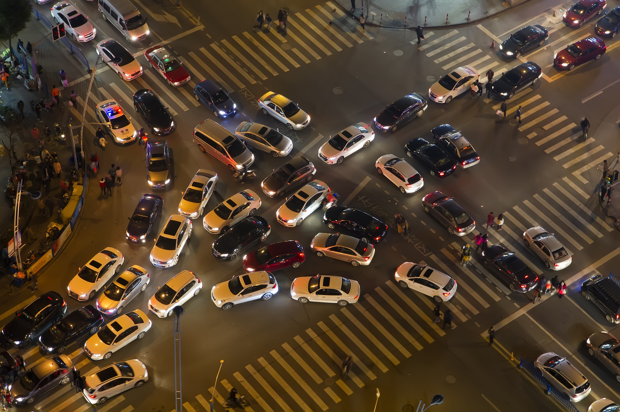
BigQuery Architecture Promises a LOT
But there are limitations

Slide 8

Structural Overview of BigQuery
BigQuery Data Storage via Colossus
BigQuery Service
Project X
Project Y
Dataset A
Dataset B
Dataset C
Dataset D
Table 1
Table 1
Table 1
Table 1
Table 2
Table 2
Table 2
Table 2
Notes:
https://cloud.google.com/solutions/bigquery-data-warehouse#datasets
Datasets – BigQuery organizes data tables into units called datasets. These datasets are scoped to your Google Cloud project. When you reference a table from the command line, in SQL queries, or in code, you refer to it by using the following construct:
project.dataset.table

Slide 9
BigQuery Slots Allocation
Processing Layer for Query Execution
1
1
2
2
1
…
…
2
999
1,999
1
…
1,000
2,000
2
…
…
…
1
1
100
9,999
..
10,000
1
50
Notes:
https://cloud.google.com/bigquery/docs/slots
When BigQuery executes a query job, it converts the declarative SQL statement into a graph of execution, broken up into a series of query stages, which themselves are composed of more granular sets of execution steps. BigQuery leverages a heavily distributed parallel architecture to run these queries, and the stages model the units of work that many potential workers may execute in parallel. Stages communicate with one another by using a fast distributed shuffle architecture, which has been discussed in more detail elsewhere.
BigQuery query execution is dynamic, which means that the query plan can be modified while a query is in flight. Stages that are introduced while a query is running are often used to improve data distribution throughout query workers.
BigQuery can run multiple stages concurrently. BigQuery can leverage speculative execution to accelerate a query, and BigQuery can dynamically repartition a stage to achieve optimal parallelization.
BigQuery slots execute individual units of work at each stage of the query. For example, if BigQuery determines that a stage's optimal parallelization factor is 10, it requests 10 slots to process that stage.
Query execution under slot resource economy
If a query requests more slots than currently available, BigQuery queues up individual units of work and waits for slots to become available. As forward progress on query execution is made, and as slots free up, these queued up units of work get dynamically picked up for execution.
BigQuery can request any number of slots for a particular stage of a query. The number of slots requested is not related to the amount of capacity you purchase, but rather an indication of the most optimal parallelization factor chosen by BigQuery for that stage. Units of work queue up and get executed as slots become available.
When query demands exceed slots you committed to, you are not charged for additional slots, and you are not charged for additional on-demand rates. Your individual units of work simply queue up.
For example,
A query stage requests 2,000 slots, but only 1,000 are available.
BigQuery consumes all 1,000 slots and queues up the other 1,000 slots.
Thereafter, if 100 slots finish their work, they dynamically pick up 100 units of work from the 1,000 queued up units of work. 900 units of queued up work will remain.
Thereafter, if 500 slots finish their work, they dynamically pick up 500 units of work from the 900 queued up units of work. 400 units of queued up work will remain.
And so on.

Slide 10
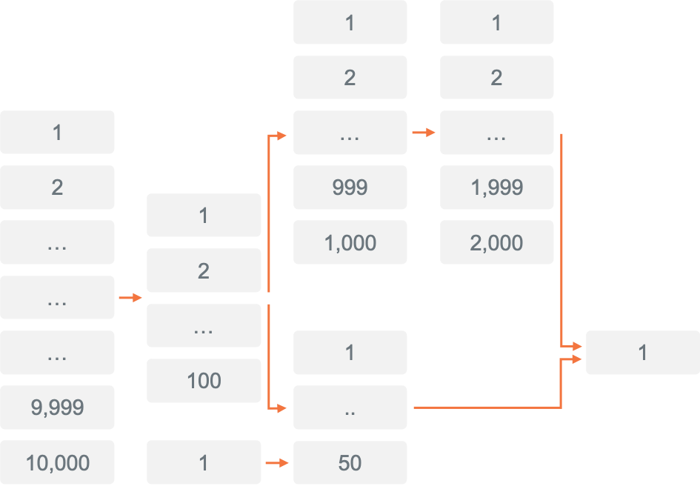
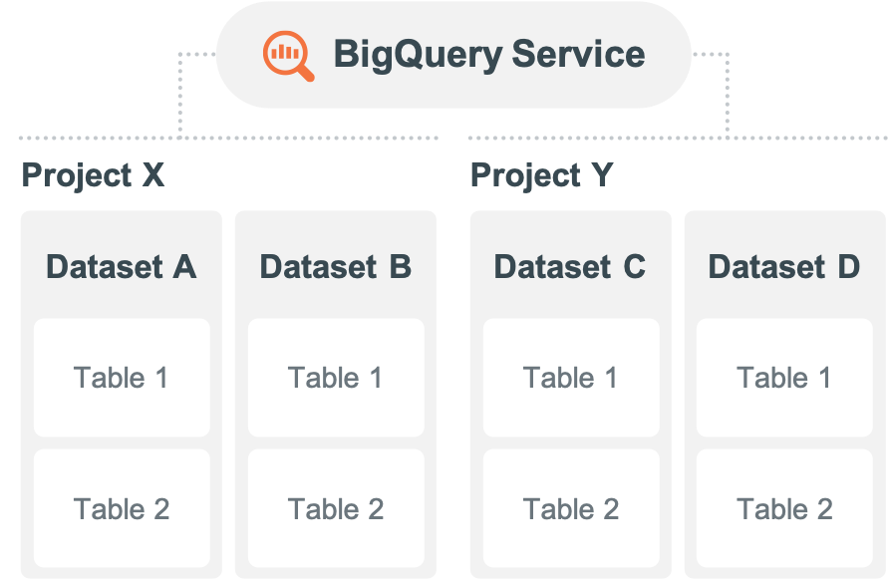
Placing Pressure on BigQuery
Stressing the link between storage and compute…
Storage
Compute
Notes:
https://cloud.google.com/bigquery/docs/slots
When BigQuery executes a query job, it converts the declarative SQL statement into a graph of execution, broken up into a series of query stages, which themselves are composed of more granular sets of execution steps. BigQuery leverages a heavily distributed parallel architecture to run these queries, and the stages model the units of work that many potential workers may execute in parallel. Stages communicate with one another by using a fast distributed shuffle architecture, which has been discussed in more detail elsewhere.
BigQuery query execution is dynamic, which means that the query plan can be modified while a query is in flight. Stages that are introduced while a query is running are often used to improve data distribution throughout query workers.
BigQuery can run multiple stages concurrently. BigQuery can leverage speculative execution to accelerate a query, and BigQuery can dynamically repartition a stage to achieve optimal parallelization.
BigQuery slots execute individual units of work at each stage of the query. For example, if BigQuery determines that a stage's optimal parallelization factor is 10, it requests 10 slots to process that stage.
Query execution under slot resource economy
If a query requests more slots than currently available, BigQuery queues up individual units of work and waits for slots to become available. As forward progress on query execution is made, and as slots free up, these queued up units of work get dynamically picked up for execution.
BigQuery can request any number of slots for a particular stage of a query. The number of slots requested is not related to the amount of capacity you purchase, but rather an indication of the most optimal parallelization factor chosen by BigQuery for that stage. Units of work queue up and get executed as slots become available.
When query demands exceed slots you committed to, you are not charged for additional slots, and you are not charged for additional on-demand rates. Your individual units of work simply queue up.
For example,
A query stage requests 2,000 slots, but only 1,000 are available.
BigQuery consumes all 1,000 slots and queues up the other 1,000 slots.
Thereafter, if 100 slots finish their work, they dynamically pick up 100 units of work from the 1,000 queued up units of work. 900 units of queued up work will remain.
Thereafter, if 500 slots finish their work, they dynamically pick up 500 units of work from the 900 queued up units of work. 400 units of queued up work will remain.
And so on.

Slide 11
Key System Metrics
{{val:bq_intro.csv[1,2]}}

Slide 12
Key System Metrics
Summary
{{val:bq_query_counts.csv[1,11]}}B
Annual queries
{{val:bq_appid_counts[1,3]}}
Applications on same platform
{{val:bq_query_counts.csv[1,8]}}M
Average queries per month
{{val:bq_query_counts.csv[1,6]}}M
Average queries per day
{{val:bq_user_counts.csv[1,3]}}
Active users, business and applications
{{val:bq_concurrency.csv[1,5]}}
Concurrent queries (peak)
{{val:bq_query_counts.csv[1,15]}} secs
Average response time
Notes:
REPLACE01

Slide 13
System Analysis
Total Users | {{val:bq_user_counts.csv[1,2]}}
Active Users | {{val:bq_user_counts.csv[1,3]}}
Tables | 56,126
Views | 21,381
Program | 000
Other | 379
Day | {{val:bq_query_counts.csv[1,5]}}
Sec | {{val:bq_query_counts.csv[1,4]}}
Year | {{val:bq_query_counts.csv[1,9]}}
Absolute Peak | {{val:bq_concurrency.csv[1,5]}}
95th Percentile | {{val:bq_concurrency.csv[1,4]}}
50th Percentile / Average | {{val:bq_concurrency.csv[1,2]}}
Average Query Runtime, Seconds | {{val:bq_query_counts.csv[1,15]}}
Maximum Space Available (TB) | {{val:bq_diskspace.csv[1,3]}}
Current Space Used (TB) | {{val:bq_diskspace.csv[1,5]}}
USERS
OBJECTS
QUERY
CONCURRENCY
DISK SPACE
Notes:
REPLACE02

Slide 14
System Analysis
Associated Migration Challenges

Slide 15
Data Transfers

Slide 16


Ingress and Egress Issues
Ingress of Data
Depends greatly on the connectivity between customers and their cloud providers
No cost
Potential data transfer bottleneck
Egress Charges
Cloud Service Providers like to keep data in and not let it out
“Usually cloud providers charge between 5 and 20 cents per GB every time you move your data from their cloud storage…”
Notes:
https://www.hostdime.com/blog/data-egress-fees-cloud/

Slide 17
Daily Data Transfers
Delete Before Sending to Customer
Suspendisse non magna ut risus posuere egestas ut vel.
A peep at some distant orb has power to raise and purify.
Vivamus gravida ac nibh vel rutrum.
A peep at some distant orb has power to raise and purify.
Notes:
REPLACE03

Slide 18
Architectural Considerations

Slide 19
Architectural Limitations for BigQuery
Based on Internal and 3rd Party Benchmark Experience
Complex Mix Workload
Large number of “operational queries”
NOT Ideal for BigQuery
Complicated Join Limitations
Large Table Limitations

Slide 20
Daily Queries Throughput
Headline placeholder
Sed elementum turpis orci, non mattis mauris viverra quis. Cras condimentum augue Bibendum.
Headline placeholder
Sed elementum turpis orci, non mattis mauris viverra quis. Cras condimentum augue Bibendum.
XXXX
Delete Before Sending to Customer
XXXX
Average {{val:bq_query_counts.csv[1,6]}}M per day. {{val:bq_query_counts.csv[1,14]}} % of the queries are sub-second
{{pic:bq--daily_query_throughput.png}}
Notes:
REPLACE04 (done)

Slide 21
Join Complexity
Tables included in each query
Tables Per Query | Query Count
1 | 123,231,877
2 | 4,145,938
3 | 547,005
4 | 923,205
5 | 279,292
5+ | 993,109
Grand Total | 130,120,426
Notes:
REPLACE05
Joins…(LEFT)
DBQL Results Package
ML_Consumption1.xlsx
Tab 4
Copy and format
Query Types… RIGHT
DBQL Results Package
ML_Consumption2.xlsx
Tab 5
Pivot Table
Copy the top X rows
Format

Slide 22
JOIN Frequency
Delete Before Sending to Customer
Last XX-Months Queries
Frequent Multi-Table JOINs
Headline placeholder
Suspendisse non magna ut risus posuere egestas ut vel nibh. Cras ut ligula auctor, feugiat leo eget, imperdiet orci. Vivamus gravida ac nibh vel rutrum. Mauris vel nulla elementum, facilisis neque at, malesuada ex. Cras nec volutpat sapien. Nunc commodo sapien ut ante laoreet molestie vitae quis magna. Curabitur at convallis enim.
Nam ac ornare ex, interdum lobortis erat. Vivamus condimentum justo eu enim sodales, ac blandit lorem tempus. In tincidunt ornare elit, quis hendrerit ligula hendrerit nec. Suspendisse potenti.
Number of Joins | Number of Queries
1 | 2,067,390
2 | 60,478
3 | 26,405
4 | 10,768
5 | 5,602
5+ | 11,139
Extremely Challenging for BigQuery to handle complex multi-way
JOINs and frequently loaded/updated data.
Notes:
REPLACE06

Slide 23
Table Size > 10GB
Delete Before Sending to Customer
XXX Tables > XXGB
DataBaseName | TableName | CurrentPerm GB
TVI | report_data | 10,034.8
CSI | config_item_obs_t | 4,162.7
CSI | config_item_obs_t_withdups | 3,953.6
CTWADMIN | REPORT_DATA_2010to2013 | 1,409.9
CTWADMIN | REPORT_DATA_2018to2021 | 1,060.2
PDCRDATA | DBQLogTbl_Hst_v1620 | 1,057.8
COR_TED_TBL | vantage_bill_log_hist | 1,042.7
CTWADMIN | REPORT_DATA_2016to2017 | 1,008.0
CTWADMIN | REPORT_DATA_2014to2015 | 990.3
COR_TED_TBL | shc_mem_free_stat | 900.5
COR_TED_TBL | shc_io_stat | 898.7
PUBLIC_CLOUD_SPEND | AWS_CUR_Billing | 887.4
COR_TED_TBL | shc_tps_stat | 779.1
tdtedw | vantage_bill_log_dn_hist_BKP | 748.1
RAW_SHC_TBL | shc_max_used_iota | 723.7
COR_TED_TBL | shc_paging_stat | 702.1
COR_TED_TBL | shc_queue_stat | 678.1
CTWADMIN | REPORT_DATA_0001to2009 | 542.8
TRDOAE | TTC_Test_Run_Case | 541.2
COR_TED_TBL | shc_swap_free_stat | 533.8
COR_TED_TBL | shc_krnl_tbl_stat | 527.6
COR_TED_TBL | shc_mem_pg_stat | 509.9
COR_TED_TBL | shc_cpu_utlztn_stat | 495.2
COR_TED_TBL | shc_swap_pg_stat | 447.4
AIC3 | _004_config_itemx_seq_t_input | 267.2
tedw | bo40_event_detail | 239.6
tedw | bo40_event_detail_ld | 239.6
ARCtest | fornparctest31 | 230.0
Headline placeholder
Suspendisse non magna ut risus posuere egestas ut vel nibh. Cras ut ligula auctor, feugiat leo eget, imperdiet orci. Vivamus gravida ac nibh vel rutrum. Mauris vel nulla elementum, facilisis neque at, malesuada ex. Cras nec volutpat sapien. Nunc commodo sapien ut ante laoreet molestie vitae quis magna. Curabitur at convallis enim.
Nam ac ornare ex, interdum lobortis erat. Vivamus condimentum justo eu enim sodales, ac blandit lorem tempus. In tincidunt ornare elit, quis hendrerit ligula hendrerit nec. Suspendisse potenti.
Notes:
REPLACE07

Slide 24
Applications and Data Extracts
Delete Before Sending to Customer
Average Rows Returned
AppID | Total Queries | Total Fetched Rows | Avg Rows Per Query
JDBC16.20.00.13;1.8.0_181 | 62 | 23,749,204 | 383,051
JDBC16.20.00.06;11.0.5 | 1,911 | 327,757,394 | 171,510
SQLA:NET:SS:17.00.02.000 | 208 | 16,569,841 | 79,662
JDBC16.20.00.12;10.0.2 | 116 | 8,452,473 | 72,866
JDBC16.20.00.08;1.8.0_211 | 13 | 738,351 | 56,796
JDBC16.20.00.10;1.8.0_181 | 163 | 7,453,363 | 45,726
JDBC16.20.00.13;1.8.0_241 | 286 | 11,669,113 | 40,801
SQLA | 4,613 | 185,040,719 | 40,112
TABPROTOSRV | 5,566 | 105,405,471 | 18,937
ARCMAP | 414 | 7,180,594 | 17,344
JDBC16.20.00.13;1.8.0_261 | 2,128 | 22,969,094 | 10,793
JDBC16.20.00.08;1.8.0_181 | 1,056 | 8,641,919 | 8,183
JDBC16.20.00.12;1.8.0_222 | 106 | 821,468 | 7,749
JDBC16.20.00.10;1.8.0_242 | 9,509 | 46,375,319 | 4,876
JDBC16.20.00.10;1.8.0_201 | 15 | 51,806 | 3,453
TDAUTOTUNE:NET:SS:17.00.02.000 | 116 | 350,415 | 3,020
SQLA:NET:SS:15.11.00.000 | 11 | 20,258 | 1,841
PYTHON | 30,596 | 54,880,134 | 1,793
JDBC16.20.00.12;1.8.0_231 | 80 | 133,674 | 1,670
JDBC15.00.00.33;11.0.5 | 10 | 12,931 | 1,293
JDBC16.20.00.13;1.8.0_192 | 1,868 | 1,638,182 | 876
TDKERNEL | 198 | 167,509 | 846
JDBC16.20.00.13;1.8.0_265 | 2,119 | 1,743,923 | 822
PYTHON.EXE | 2,198 | 1,541,852 | 701
Headline placeholder
Suspendisse non magna ut risus posuere egestas ut vel nibh. Cras ut ligula auctor, feugiat leo eget, imperdiet orci. Vivamus gravida ac nibh vel rutrum. Mauris vel nulla elementum, facilisis neque at, malesuada ex. Cras nec volutpat sapien. Nunc commodo sapien ut ante laoreet molestie vitae quis magna. Curabitur at convallis enim.
Nam ac ornare ex, interdum lobortis erat. Vivamus condimentum justo eu enim sodales, ac blandit lorem tempus. In tincidunt ornare elit, quis hendrerit ligula hendrerit nec. Suspendisse potenti.
Notes:
REPLACE08 -- bq_appid_detail.csv

Slide 25
System Platform Limitations

Slide 26
Understanding Platform Limitations
Comment from Jmyers:
As far as I know… this is spelled correctly?
What dictionary is being used here?
French. Change it to English and it went away ☺ Fawad
BigQuery Quotas and Limits
Description | Limit
Concurrency | 100 queries
Concurrency for External Sources | 4 queries
Queries with UDF | 6 queries
Inserts per Table | 1500/day/table
Query Execution Time Limit | 6 hours
Load jobs per table per day | 1500
Load jobs per project per day | 100,000
Max # of partitions per table | 4000
Max Query Response Size | 10GB
Notes:
https://cloud.google.com/bigquery/quotas
Customers can request to get some of the limits changed but they will always be finite.
Change to the limits results in extra cost which is not advertised publicly.
Google may increase the daily limits but they will never be eliminated because of the Serverless design

Slide 27
Number of Tables Having > 1500 Insert/Update/Delete
Delete Before Sending to Customer
On an average XX Tables break the BigQuery limits on a daily basis
Headline placeholder
Suspendisse non magna ut risus posuere egestas ut vel nibh. Cras ut ligula auctor, feugiat leo eget, imperdiet orci. Vivamus gravida ac nibh vel rutrum. Mauris vel nulla elementum, facilisis neque at, malesuada ex. Cras nec volutpat sapien. Nunc commodo sapien ut ante laoreet molestie vitae quis magna. Curabitur at convallis enim.
Nam ac ornare ex, interdum lobortis erat. Vivamus condimentum justo eu enim sodales, ac blandit lorem tempus. In tincidunt ornare elit, quis hendrerit ligula hendrerit nec. Suspendisse potenti.
Notes:
REPLACE09

Slide 28
Databases with Most Frequent INSERTS/UPDATES/DELETES
Delete Before Sending to Customer
ObjectDatabaseName | Avg Statement Count Per Table
TVI | 56,130
fincrime_bustout | 6,553
fincrime_bustout_dev | 3,932
VCX_Application | 3,581
ADLSLSAMER_Qualcomm | 2,781
fincrime_aml | 2,002
fincrime_cnp_dev | 1,934
Headline placeholder
Suspendisse non magna ut risus posuere egestas ut vel nibh. Cras ut ligula auctor, feugiat leo eget, imperdiet orci. Vivamus gravida ac nibh vel rutrum. Mauris vel nulla elementum, facilisis neque at, malesuada ex. Cras nec volutpat sapien. Nunc commodo sapien ut ante laoreet molestie vitae quis magna. Curabitur at convallis enim.
Nam ac ornare ex, interdum lobortis erat. Vivamus condimentum justo eu enim sodales, ac blandit lorem tempus. In tincidunt ornare elit, quis hendrerit ligula hendrerit nec. Suspendisse potenti.
Notes:
REPLACE10

Slide 29
Dictionary and Schema Analysis

Slide 30
GAPS IN BIG QUERY
Blockers to Successful Migration
Primary Indexes
41,744 UPI Defined
Column Formatting
1,331,017 Column Formats
Table Structures
57,670 SET tables out of 85,104 (67%)
0 Global Temporary Tables
544 Join Indexes
Partitioning
5,041 PPI Defined
Special Data Types
198 INTERVAL
1,224 PERIOD
2,800 NUMBER
428 BLOB > 8MB
2,189 CLOB > 16MB
386 XML/JSON
534 Geospatial
Constraints
5,158 Check Column Constraints
3,618 Primary Key Constraints
246 Foreign Key Constraints
Notes:
REPLACE11
System database excluded:
DatabaseName NOT IN ('All', 'Crashdumps', 'DBC', 'dbcmngr’, 'Default', 'External_AP', 'EXTUSER', 'LockLogShredder', 'PUBLIC','Sys_Calendar', 'SysAdmin', 'SYSBAR', 'SYSJDBC', 'SYSLIB','SystemFe', 'SYSUDTLIB', 'SYSUIF', 'TD_SERVER_DB', 'TDStats','TD_SYSGPL', 'TD_SYSXML', 'TDMaps', 'TDPUSER', 'TDQCD','tdwm', 'SQLJ', 'TD_SYSFNLIB', 'SYSSPATIAL')

Slide 31
GAPS IN BIG QUERY
Primary Indexes
Not having PI will require complete remodelling and will dramatically reduce performance especially for tactical queries.
Column Formatting
Column Formatting allows you to control data type precision and if not handled properly in the ETL logic can cause reconciliation issues.
Blockers to Successful Migration
Table Structures
SET tables enforce uniqueness automatically, absence of this capability will require moving this complex logic to ETL
Global Temporary tables will need to be handled in the ETL as well
Partitioning
Column Formatting allows you to control data type precision and if not handled properly in the ETL logic can cause reconciliation issues.
Special Data Types
These data types provide specialized business capabilities such as Time Series, Geospatial, Temporal, Unstructured Data processing. Absence of the data types will make it really difficult to provide these business capabilities.
Constraints
All the constraints handled by the database would need to handled by ETL which will significantly increase ETL effort and it can cause reconciliation issues.
Notes:
System database excluded:
DatabaseName NOT IN ('All', 'Crashdumps', 'DBC', 'dbcmngr’, 'Default', 'External_AP', 'EXTUSER', 'LockLogShredder', 'PUBLIC','Sys_Calendar', 'SysAdmin', 'SYSBAR', 'SYSJDBC', 'SYSLIB','SystemFe', 'SYSUDTLIB', 'SYSUIF', 'TD_SERVER_DB', 'TDStats','TD_SYSGPL', 'TD_SYSXML', 'TDMaps', 'TDPUSER', 'TDQCD','tdwm', 'SQLJ', 'TD_SYSFNLIB', 'SYSSPATIAL')

Slide 32
Summary

Slide 33

Review of Vantage Internals
Comment from Jmyers:
This “header” might be too technical, but that’s really a problem for the design…
Just needs to be resolved before the automation stage. Court’s note: Suggest a more “story-oriented” approach: Provide a high-level view of environment
INCREASES understanding. Of risks associated with performance, quatas and limits, Schema
DECREASES risk of making the wrong decision when choosing to migrate
or something like that
To provide a high-level view of the platform environment
Understanding risks associated
Performance
Quotas and Limits
Schema
Will lower the risk of making a “wrong” decision associated with a migration

Slide 34
Teradata + Public Cloud = Lowest Risk, Fastest Time to Value
Migrating to the same data model and Vantage software accelerates the journey to the cloud,
enables progress in advanced analytics and drives new value
Timeline for Teradata in Public Cloud
Premigration testing
Post migration tuning
ADVANCED AND NEAR-REAL TIME ANALYTICS POWERED BY VANTAGE
Bank of the Future
Cost Efficiency;
CX improvement;
Marketing, Sales & Care services digitization.
Analytical value being delivered
Comment from Jmyers:
This depends on the competitor?
Or we should use a ‘common’ header such as
“Timeline for other database offerings”
Migration delivered
Migration
Open data platform for business and digital partners
Discovery and analysis
Multi-channel, hyper-personalization of the Customer Journey
2021
2022
2023
2024
Timeline for for other Cloud native database offerings
Parallel running to enable business continuity
Extensive re-engineering and parallel running drives high-cost;
Resources and management time diverted merely to re-implement existing functionality.
Data Structure Design
Migration and testing of 30+ high priority applications and associated ETL processes
Migration delivered
Ecosystem analysis
Develop and test new data structure
Rearchitect and develop downstream systems
Subject matter experts and data scientists tied up supporting migration
Notes:
Cloud native database offerings

Slide 35

Questions and Answers

